Slide 1
Course Introduction
Lecturer: Ngo Huy Bien
Department of Software Engineering
Faculty of Information Technology
University of Natural Sciences, VNU HCMC
nhbien@fit.hcmus.edu.vn

Slide 2

Lecturer
Ngô Huy Biên, PhD
Department of Software Engineering
Faculty of Information Technology
University of Natural Sciences, VNU HCMC
Email: nhbien@fit.hcmus.edu.vn
Phone: 09884x7y2z.
Office location: I82.
Office hours: Wednesday & Thursday: 13:30 p.m. – 17:10 p.m.

Slide 3

Objectives
To decide whether to register for the course.
To identify a group for implementing the course project.
To estimate an expected grade for yourself.

Slide 4

Contents
Course target learners.
Course learning outcomes.
Course contents.
Course schedule.
Course assessment.
Teaching and learning methods.
References.
Course policies.

Slide 5



I am a Student
Should I learn this course?

Slide 6
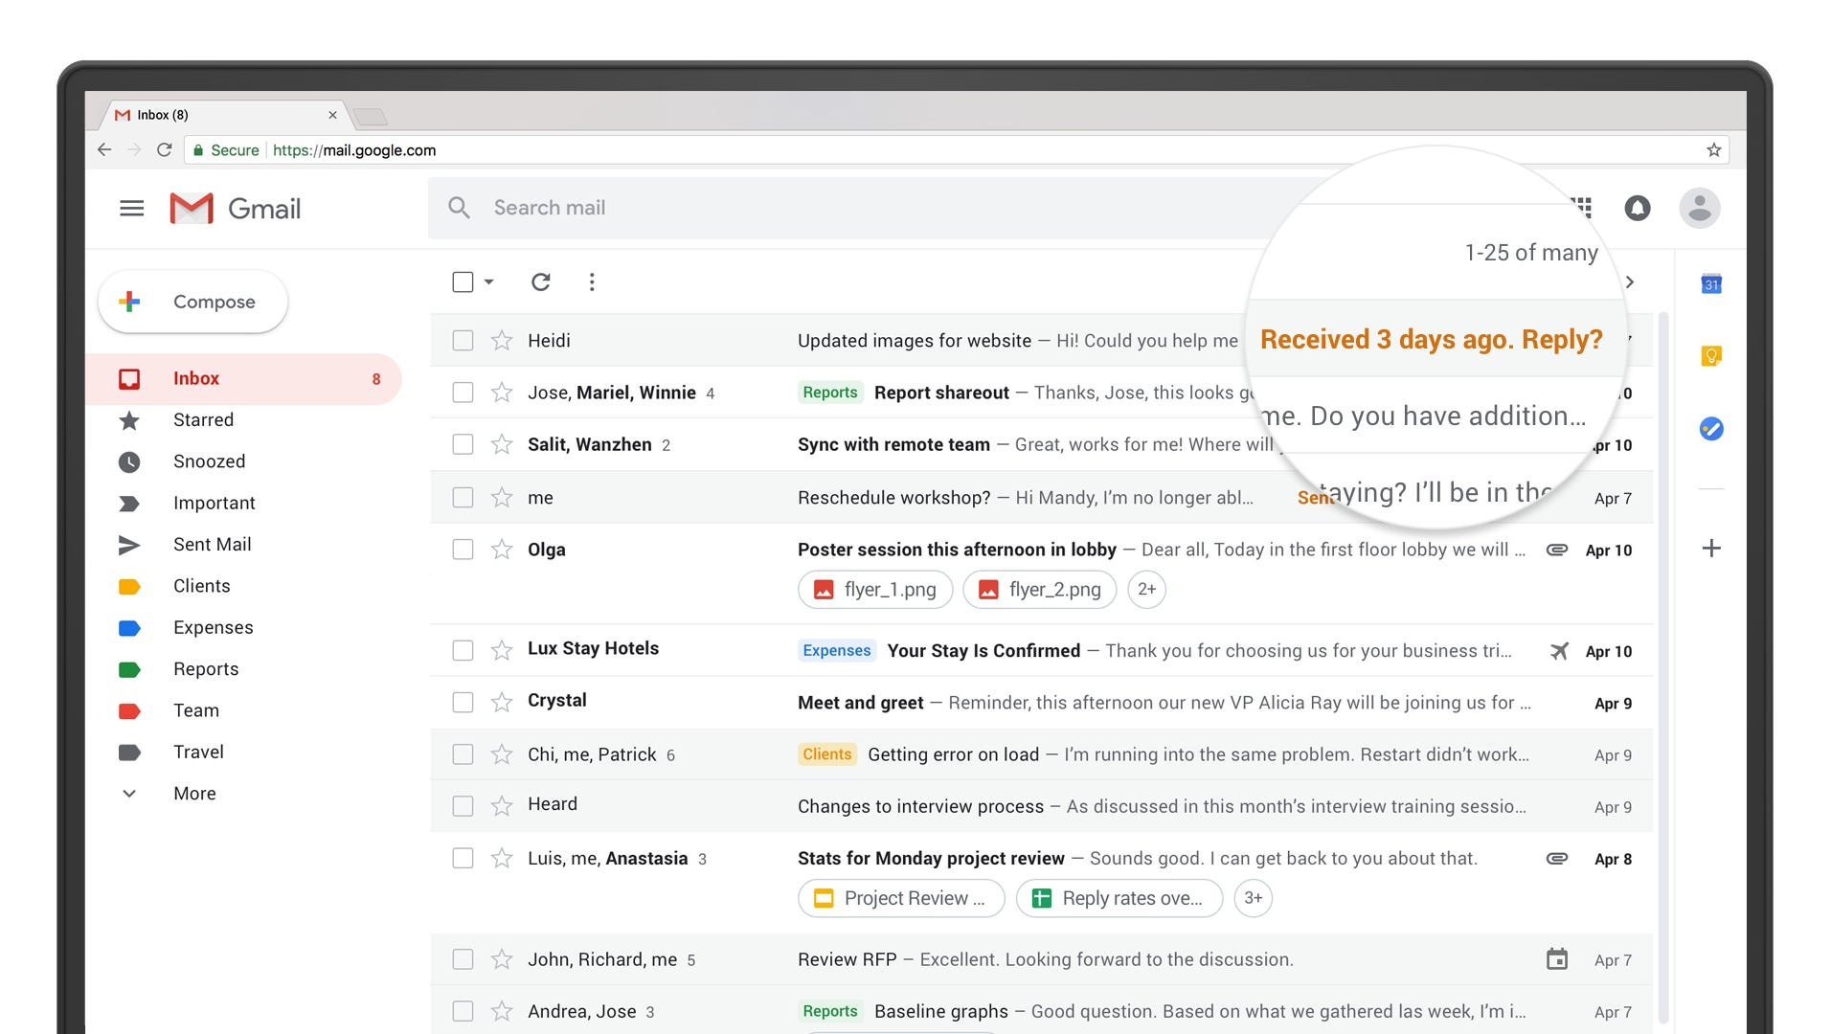
I am a Student
Should I learn this course?

Slide 7

I am a Developer
Should I learn this course?
Web developer salaries can range from $500 to $1400 USD per month.

Slide 8

This Course is Not for
people who already can develop a dynamic web application.
people who do not like programming.

Slide 9



Course Prerequisites
Prerequisites:
Introduction to Programming.
Introduction to Database Management Systems.
Prior-courses:
Computer Networks
Introduction to Software Engineering
Parallel courses:
Windows Programming
Software Requirements
Required knowledge and skills:
The ability to read English books.
The ability to write reports.
The presentation skill.

Slide 10

Course Learning Outcomes
Explain web application architecture
Install HTTP services
Write a HTML web page
Write CSS for a web page
Write JavaScript code for a web page
Write a dynamic web page
Use tools, libraries and frameworks for creating, testing and deploying a web application.
8. Engineer 14,000 lines of code a web application with a team of 7 people.

Slide 11


Course Contents
Web Application Architecture, HTTP Services (Web Servers) and Clients
HTML
Web Design, CSS and Responsive Website
JavaScript and JSON
jQuery, Bootstrap and Font Awesome
Single Page Application (React, Angular, Vue.js)
Server side programming languages and frameworks: C# and .NET Core/PHP/Java and Java EE/JavaScript and Node.js/Python and Django and Flask/Ruby and Ruby on Rails
Web Database Application (MS SQL, mySQL, Oracle, MongoDB)
Web API (Web Services)
Web Application Security, Testing, and Deployment (Docker, Kubernetes, Heroku, Firebase Hosting)
Details: Refer to the course syllabus.

Slide 12

Course Schedule
The number of credits: 4
Theoretical lessons: 45
Practical lessons: 30
Self- learning lessons: 120
Detailed schedule: Refer to the course syllabus.

Slide 13

Classroom Leaders

Slide 14


Team Building
Select 8 team leaders.
Students select a team for themselves. Each team has maximum of 7 members (including a team leader).
If there are surplus students, some teams can have 8 people.
Team leaders send their team members list to class leader.
The class leader collects and puts all the information to a class management file.
The class leader is authorized to assign a team for an individual who is late to class or absent.

Slide 15


Course Assessment
The final grade is combined of:
2 individual tests in classroom (20%)
Team project (30%)
Bonus points (up to 10%) for:
Students who actively answer questions in classroom correctly
Personnel board (1 class leader and 1 deputy class leader)
Detailed assessment: Refer to the course syllabus.

Slide 16

Individual Tests in Classroom (20%)
Individual test #1: 10%
Individual test #2: 10%
Test date will not be noticed.

Slide 17
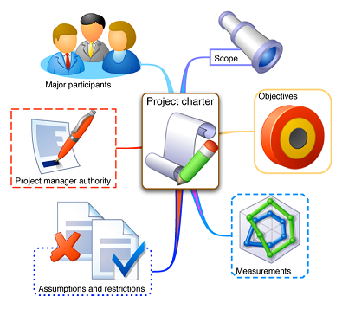

Team Project (30%)
Each team selects a topic for project.
Lecturers will decide which topics will be approved, or will offer alternative topics, guide the basics, lead the development of projects for students, give feedback for results, and answer students' questions.
Students need to read the theory materials in advance and review the sample products, work on a team project, present weekly and mid-term products, and submit all final products at the end of the term.

Slide 18

Course Policies
Students who are absent for more than 30% of the course time shall not be allowed to take the exams.
Students who are graded 0 for the course project or for the total score of the individual tests shall not be allowed to take the exams.
Students who are absent during a test session will be graded 0 for the test. The exception can only be applied to students who have a hospital certificate of medical status.
Students who does a classroom test or homework or project for their friends will be graded 0 for the course.
Students who do plagiarism for their exercises or projects will be graded 0 for the course. This also applies to cases in which the lecturers find out later when students will have already completed the course.
Students who have proof of their friends’ cheating or plagiarism but do not notify the lecturers will be deducted 50% of the total grade that they will have achieved.

Slide 19


Lectures & Slides
Lectures contain the core knowledge with specific examples.
Slides present general knowledge and provide details to lectures.
Lectures & Slides are not necessarily the same.
Writing summary for lectures as articles → Bonus points.

Slide 20

References
Specific materials for each course topics: Refer to the course syllabus.

Slide 21

Questions and Answers

Slide 22

Thank You & See You Again

